Slide 1
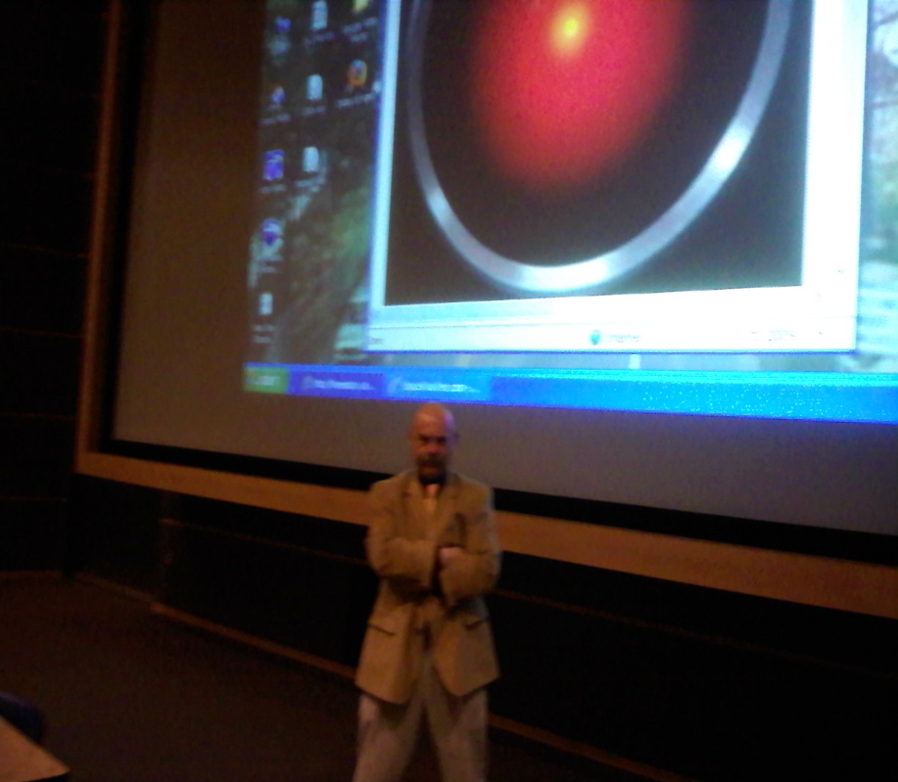
gms - 2012
Using video to establish connection with students in cyberspace
Dr. Gerry Santoro
IST/CAS
Penn State University

Slide 2

gms - 2012
Assertion:
Video can be an effective tool for establishing a connection between students and an online course.

Slide 3
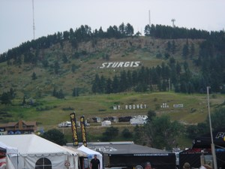
gms - 2012
Purpose of this talk
Demonstrate how I use video to develop connection in online courses
Provide a few examples to spur your imagination
Explain the simple, and free, method I employ

Slide 4
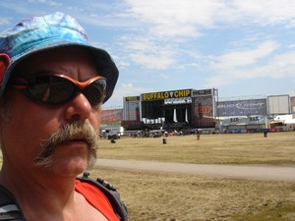
gms - 2012
An example
Week 11 video for Online IST-250 (Web Development)
Location – “Gravity Hill” near Bedford, PA
http://ist-250fall2011.weebly.com/weeks-10-12.html

Slide 5
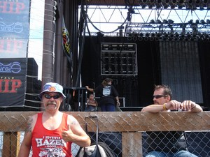
gms - 2012
A little bit about me…
at leading edge of IT in academia since 1967
systems programmer/analyst/manager for 26 years (Pitt and Penn State)
  microcomputer and desktop workstation support
  first Penn State LANs
  microcomputer labs and classrooms
  desktop/LAN security
  computer store and distributed computing

Slide 6
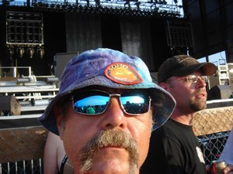
gms - 2012
A little bit about me…
worked with Phil Cartwright to establish CBEL in 1986
  later known as ETS and now TLT (part of ITS)
  coordinated effort to bring microcomputing and use of Internet to Penn State classes
  Contributor to first Penn State Symposium on Distance Education (86/87)

Slide 7
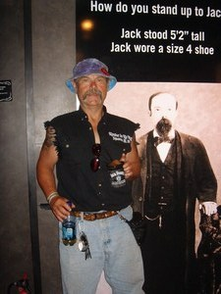
gms - 2012
A little bit about me…
MS in Interdisciplinary Information Science (Pitt – 1984)
PhD in Interdisciplinary Communication and Information Science (Penn State – 1988)
CAS faculty teaching/developing courses incomputer/Internet applications (LA-283/483 - first Internet-based Penn State courses)
IST faculty beginning in 1999
  Intro IST/SRA courses
  Emerging Technologies and
  Entrepreneurship
  Web Design and Development
  Popular Culture and Technology
  Computer and Network Security, Cyber-
  Forensics, Risk Analysis, Security
  Management
  Online courses in Web Development, Security
  Management, Cyber-Forensics

Slide 8
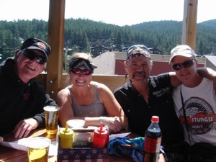
gms - 2012
Perspective:
  Information Technologies are essentially Communication Technologies
  They are two sides of the same thing
  This is especially true in teaching/learning as this is primarily a communication process
    Instructor—student
    Student—student
    Student-- instructor
    Course materials -- student

Slide 9
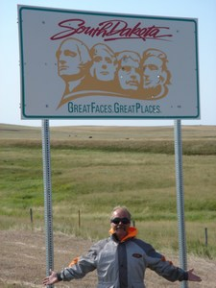
gms - 2012
Enter video …
  Digital video technologies have made quality video accessible
  Many free programs exist for video editing and development
  Video can be captured on inexpensive devices, digital cameras, and even many cell phones
  Many free services exist for publishing digital video
  Video players are free and integrated into many Web browsers
  Broadband and wireless technologies have increased audience for video

Slide 10
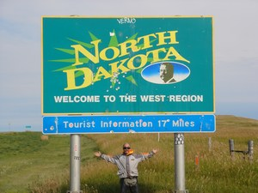
gms - 2012
Why do this?
Students will do better in a course if they feel ‘connected’ to it, the instructor and the other students
Spatial asynchronicity can be a barrier to establishing this connection
For example, a student in Rapid City, SD can find it difficult to feel a ‘part of Penn State’
Adult learners can especially benefit from the sense of connection

Slide 11
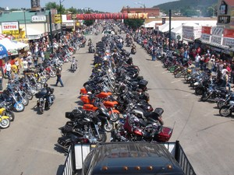
gms - 2012
Some points
  The videos are ‘added value’
    All information is available through a posting, in the syllabus, through an announcement, etc.
    The videos are an option for students who want to experience them
  From feedback I have most do, and most really enjoy them
  Transcripts are provided to meet Section 508 and ADA accessibility guidelines

Slide 12
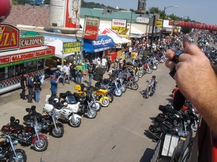
gms - 2012
So how do I do this?
  I start with a semester plan
    What are the goals of the videos?
  Weekly introductory videos
    What we are covering, what is due this week, advice on projects/quizzes, etc.
    Highlight different location around campus of Central PA
    Incorporate fun element
    Informal

Slide 13
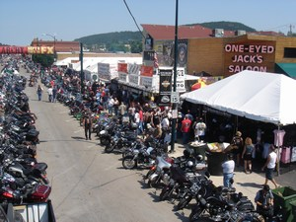
gms - 2012
So how do I do this?
  Other ideas:
    Mini-lectures
      Not to be confused with video of regular lectures of course content
      Course content lecture videos are intended for re-use
      Mini-lectures focus on specific areas where students may need help, are informal, and ad-hoc
    Relevant news and issues
    Specific class-wide semester feedback on projects

Slide 14

gms - 2012
Example 2:
  Week 5 video for Online IST-456 (MPS)
  Location – Palmer Museum of Art
  http://ist-456-mps-sp12.weebly.com/weeks-4-6.html

Slide 15

gms - 2012
Using weekly intro as example:
  Initial planning
    Location for each video
    Information to include in video (get this from syllabus)
  I try to have this as complete as possible so I can plan video/picture capture in logical groups according to location

Slide 16
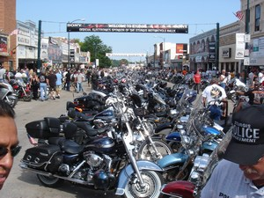
gms - 2012
Using weekly intro as example:
  Develop scripts
    Good script is essential
    Allows for some research on location
    Coordinate location with time of year – example is Beaver Stadium for football season
    Ensures that important information is covered in logical manner
    Script can be published for accessibility
  I like to develop all of the scripts in a category for the entire semester before beginning to do video/picture capture

Slide 17
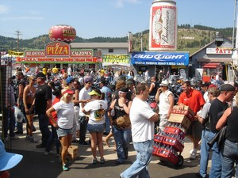
gms - 2012
Using weekly intro as example:
  Capture video/pictures
    I use an inexpensive tripod ($30) and a digital camera – Nikon Coolpix L100 (about $200)
      Important to consider video capture format – although many programs exist for format conversion
      When I use Flip I convert mp4 to avi before editing
      I capture voiceover with the video
    Background noise and wind can be audio problem
    People in background can be positive
    Screenshots from Web pages can be used carefully

Slide 18
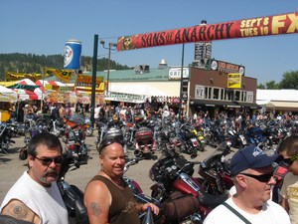
gms - 2012
Using weekly intro as example:
  Locate Royalty-Free music
    Consistent intro/ending music can brand a set of video
    I use creative commons music at
    www.incompetech.com
    Sometimes I make my own music

Slide 19
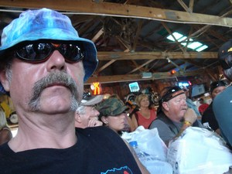
gms - 2012
Using weekly intro as example:
  Edit video
    Many free editors for digital video
      I use Windows Movie Maker
    Timeline arranges video and pictures
    Transitions and special effects can be applied (fade in/out)
    Separate video and audio tracks allow for voiceover
    Labels and credits can be added

Slide 20
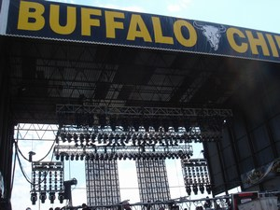
gms - 2012
Using weekly intro as example:
Edit video
More complex effects can be developed by making smaller videos and then adding them together
Easy voiceover can be achieved by copying audio of video track into music track
Publish for best quality on computer
Be sure to use format that video staging service allows (YouTube does WMV, AVI and MP4)

Slide 21
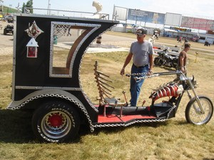
gms - 2012
Using weekly intro as example:
Edit video
Preview final product before moving it to staging area
You may need to make changes
Be sure to save video edit file and all materials – allows for some reuse
Place transcript on Penn State Personal Web space for student access (could also place it on ANGEL)

Slide 22
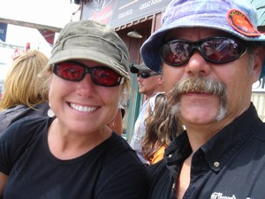
gms - 2012
Using weekly intro as example:
Edit video
Publish video to online service
I use a separate YouTube account to stage videos
I list them as ‘private – requiring URL to view’
I publish at highest quality
I also publish them as Creative Commons – fair is fair…

Slide 23
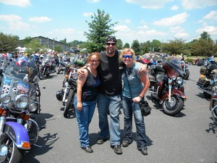
gms - 2012
Using weekly intro as example:
Organize videos
I use a free Weebly.com.com Web page to easily organize the videos, add links to transcripts
The Weebly.com page is set up according to week of the semester – to easily correspond with the syllabus
I place a link to the Weebly.com page in my class resources on ANGEL

Slide 24
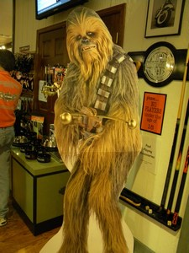
gms - 2012
But I cannot do this…
  The tech is too hard … bull!
    Kids are doing this – my students learn to create video with no help or instruction from me other than a general approach (as I provide here)
    There are many, many help and troubleshooting guides online for video creation
    Some are program-specific
    Others are in video form
    If you play with it you will quickly figure it out

Slide 25

gms - 2012
But I cannot do this…
  What if I need help?
    Many schools have media centers that will assist – such as Penn State’s Digital Commons
    Colleagues could be a source of help
    Students can be a source of help
    But don’t expect them to do it for you unless you provide $$$

Slide 26
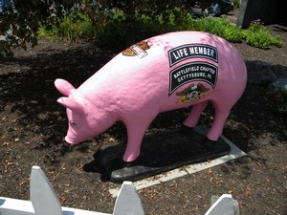
gms - 2012
But I cannot do this…
  It will take too much time
  Not really – it will take more time in the beginning, as you become familiar with the tools
  Afterward it becomes fairly efficient
    Takes me about 3 hours – start to finish and including travel time (on average) for a quality 5-8 minute video
    Even less time if I am making video from my office or home
  Of course it will take some time commitment – expecting big payback without any investment is foolish

Slide 27

gms - 2012
But I cannot do this…
  I am worried about copyright
    You do not have to publish as Creative Commons if you do not wish to
    Content you exclusively create – or create using royalty-free pictures/video/sound is your property
      Be sure you only use royalty-free sources and attribute them correctly
    Screenshots may be allowed if you follow DMCA TEACH provisions
      Such as limiting access

Slide 28
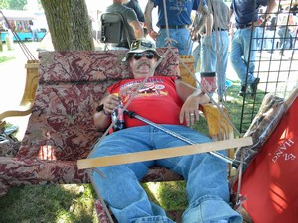
gms - 2012
Tips and suggestions
  Start early
    Be sure your syllabus is complete – but then begin thinking early about how video may be effectively utilized
  Don’t get hung up on ‘professional quality’
    You are not George Lucas!
    It is possible to create video of surprisingly high quality with free tools
    Students are very accepting, possibly more accepting, of amateur video – the added expense for professional polish is not worth it

Slide 29
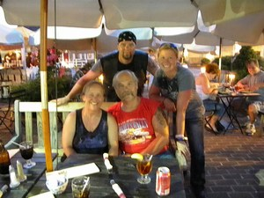
gms - 2012
Tips and suggestions
  Develop a brand
    A consistent set of music for opening and ending, and a consistent overall structure, can help to brand your video (and course)
  Try to show your personality
    Include hobbies, pets, family, home, etc.
    Interesting locations or events can be fun
    Gives students a sense of ‘being there’
  Make frequent backups of everything while editing
    Can be frustrating if the editor freezes before you are finished

Slide 30
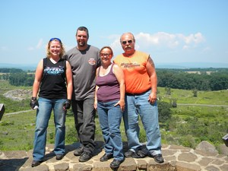
gms - 2012
Tips and suggestions
Play with it first
Start by making a fun video for family and friends
Kids video to Grandma
Video of vacation
Video at arts festival or other fun event
Use YouTube to publish it
With a little practice comes skill
Use Weebly.com video page to also publish fun, inspirational and educational links to other free video
http://ist-250fall2011.weebly.com/weeks-10-12.html
Notes:
Here’s to the crazy ones!

Slide 31
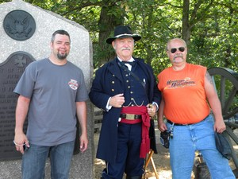
gms - 2012
Questions?????

